Slide 1
AWS – ELB (Elastic Load Balancer) & AutoScaling (AS)
Vishwanath m s
VISHWACLOUDLAB.COm

Slide 2
AWS – ELB (Elastic Load Balancer)

Slide 3
TCP/IP Layer
TCP/IP Layers
Application
Port No
1 to 65536
Load Balancer works on the Application layer and does per PORT load Balancing
Load Balancer provides HIGH AVAILABILITY ON APPLICATION LAYER
Transport
TCP/UDP
Network
IP address
Datalink
MAC Address

Slide 4
Scenario Diagram for Internet Facing
External
Inside
Vishwacloudlab.com
Load Balancer
VM01
Port - 80
Internet Traffic
VM02
Port - 90
Port - 80
VM03
Port - 80
Public IP & Public DNS
Private IP from Subnet

Slide 5
Concepts of ELB (ElasticLoadBalancer)
Multiple options are
Application Load Balancer -- ALB
Network Load Balancer -- NLB
AWS Classic Load Balancer-- CLB
Application Load Balancer
To perform LB on HTTP and HTTPS
Network Load Balancer
To perform LB on any TCP port
AWS Classic Load Balancer
Previous Generation → HTTP, HTTPS and TCP

Slide 6
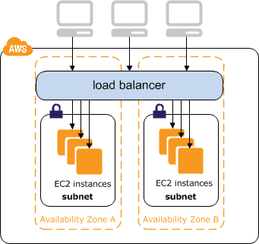
Concepts of ELB (ElasticLoadBalancer)
LoadBalancer is used to share the Load, so that we DON’T have a single point of failure for the service.
AWS LoadBalancer has 2 Parts in it
Create Load Balancers – To configure the Front End
Create Target Groups -- To configure the Back End
A LoadBalancer can also work on IPV6 public IP but only
In “Application LB”.
A LoadBalancer is a request Forwarder and does not
Acknowledge to the request itself to the end users.
A LoadBalancer works WITHIN the VPC.

Slide 7
Diff B/w ALB vs ELB vs CLB
Details | Application Load Balancer | Network Load Balancer | Classic Load Balancer
Cloudwatch Metrics | Yes | Yes | Yes
Load Balancing to multiple port on the same machine | Yes | Yes | NO
Protocols | HTTP, HTTPS | TCP, TLS | TCP, SSL/TLS, HTTP, HTTPS
IP addresses as Targets | Yes | Yes
Path-based Routing | Yes | NO | NO
Sticky-Session | Yes | No | Yes
Back-end server Encryption | Yes | Yes | Yes
Static IP & Elastic IP | No | Yes | NO

Slide 8
Application Load Balancer
Pre-requisite
We need to have minimum of 2 Subnets and these 2 subnets should be in 2 different Availability Zone.
Configuration
Only 1 subnet can be selected in an Availability Zone
Also supports Ipv6 on the FrontENd of Loadbalancer

Slide 9
Create Load Balancer
4 Sub steps
Sub-Step1: Configure Load Balancer
Sub-Step2: Security Group
Sub-Step3: Configure Routing
Sub-Step4: Register Target

Slide 10
Step1: Load Balancer Configuration Configuration has 2 sub parts
Front End
Whether the LB has to “internet Facing” Or “Internal” facing
The Front-end Public IP is created Automatically for “Application LB”
We have a option to assign an Static Public Ip (ElasticIP) for “Network LB”
Back End
For Application LB
We need to add a VPC that has a min of 2 Subnets in 2 Different Availability Zone.
For Network LB
We can have a min of 1 Subnet in the backend.

Slide 11

Step2: Security Group
Since LB is an individual feature, we need to specify what traffic can come in.
Security Group option is available only in “Application LB” and NOT in “Network LB”.

Slide 12
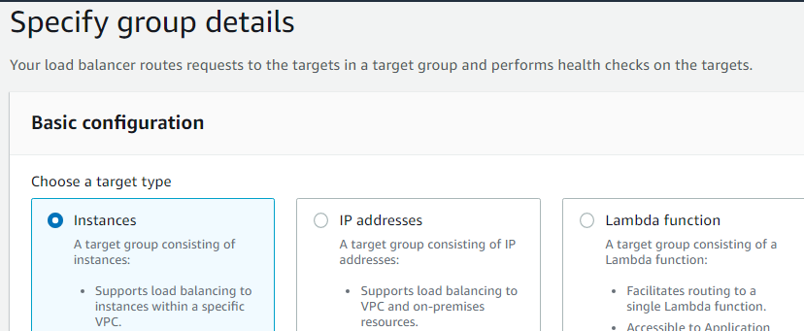
Step3: Configure Routing
This is configured to monitor the Backend port of the Load balancer, that is the webserver port running on the EC2 instance.
Health Check configured to monitor even the path of the webserver file.

Slide 13
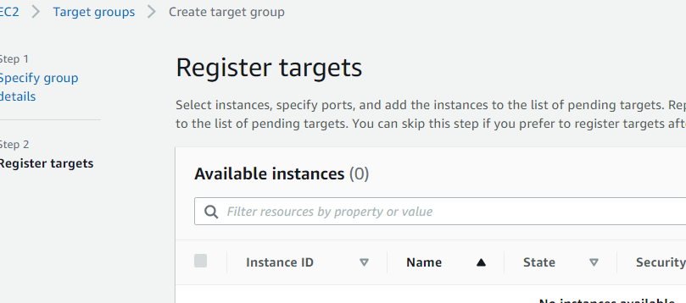
Step4: Register targets
We can register the EC2 instance at any point of time.
We can also register the same EC2 instance, multiple times on different ports.

Slide 14
After the Creation of LB
There is an Automatic “DNS” name created by AWS, also called as “A Record” for IPV4 or “AAAA Record” for IPv6.
For “Application LB” the IPV4 and IPV6 address is automatically assigned.
In case of “Network LB”, we have an option to use an Elastic IP for the LB DNS name.

Slide 15
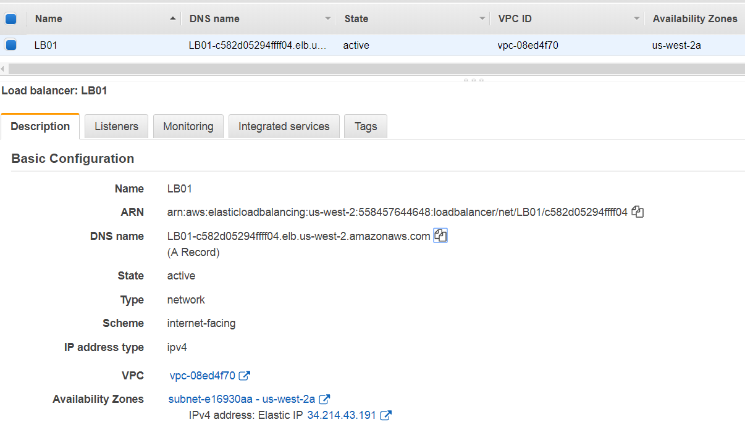
Network Load Balancer

Slide 16
AWS – AutoScaling (AS)

Slide 17
AutoScaling
It can Scale Out and Scale in of Virtual Machine (EC2 instances)
1
During Scale In, the VM’s are deleted in FIFO Manner (First in First Out)
2

Slide 18
Conditions available
CPU Utilization
Network IN/OUT
Disk read
Disk write

Slide 19
Scale Out Flow
If the Avg CPU utilization is Above 40% add one instance
VM01
VM02
VM03

Slide 20
Scale IN Flow
If the Avg CPU utilization is Below 20% Delete one instance
VM01
VM02
VM03

Slide 21
Autoscaling Creation 2 Parts in it
Launch Configuration
Autoscaling Group

Slide 22
Auto Scaling Launch Configuration
Options Configured for an EC2
AMI
Instance type
Launch Config name with Advance Details
Specify whether IPV4 public is required are not on each EC2 instance
Disks/Volume
Security Group
KEYS

Slide 23
Autoscaling Group
Configure Autoscaling Group Details
Autoscaling Group Name.
Initial Size of the Group
Network /Subnets ( Select the same VPC that was selected for the SG in the Launch Configuration)
Under the Advance Config
Instance Scale IN Protection – This would protect all the scaled EC2 instance from SCALE IN. Means NO SCALE IN will happen.
Scaling Policy

Slide 24
Deleting VM’s in Autoscaling
If you delete all the VM’s in the Autoscaling, Autoscale would create the min VM’s as per the configuration again.
If you want to delete all the VM’s in the Autoscale, then DELETE the AUTOSCALE GROUP

Slide 25
Autoscaling Use Case:
Scaling Website’s within the same Availability Zone
Automatically scale the Website across Availability Zone.
Note: -- Autoscaling CANNOT be across 2 VPC’s or 2 regions.

